Slide 1
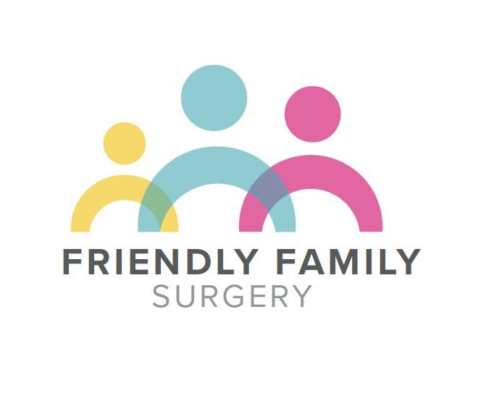
Friends and Family Test Results
November 2025
,
Thank you to all our patients who took the time to complete a ‘friends and family test’ for us in November. Here are some of the comments we were left.
81.5% would be ‘extremely likely’ to recommend us to friends and family if they needed similar treatment. The remaining 18.5% said they would be ’likely’to.
To read more about the NHS Friends and Family Test and to complete a form please click this link or ask at Reception
NHS Friends and Family Test – Friendly Family Surgery
Reception always polite and understanding Medical staff first class, getting to see a Doctor is something else!
No worries or disappointment with the care I receive.
Always extremely helpful
Always prompt service
Always accommodating, trying their best. The receptionists, nurses and doctors listen to you. Dr. Ray has been very caring, giving me and my family excellent treatment.
Dr Ritchie most thorough and caring Dr I have ever known in my long life
Excellent service
I have always received professional care from here
Always go above and beyond to help which I appreciate

